Slide 1
Social Network Analysis
Stats & Methods Training Seminar

Slide 2
Overview
Social network data
  Types of social networks
  Social network data
  Graphical representation of social network data
Characterizing the network and the nodes (I)
  Density
  Centrality
  Prestige
Characterizing the network and the nodes (II)
  Cohesive Subgroups
  Structural Equivalence
  Blockmodels
Statistical models for social network data
  P* models

Slide 3
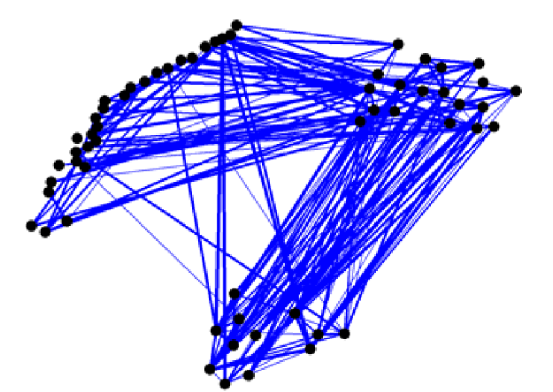
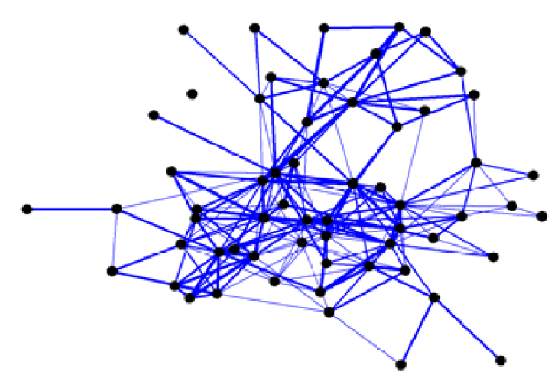
Why model social networks?
There are many descriptive techniques that provide insight into an observed network
  Density, centrality, cohesive subgroups, structural equivalence
But models provide some clarity of major effects

Slide 4
Why model social networks?
Competing explanations for structural effects:
  The appearance of triangles can occur through different social processes
    A balance-type effect
    A homophily effect
  Only a model that includes both effects can help decide whether one or both are important
The question is: For an observed network, which local network processes may be implicated in its emergence?

Slide 5
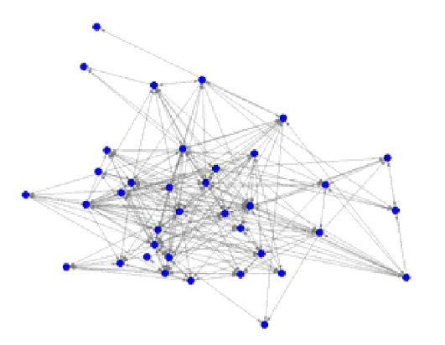
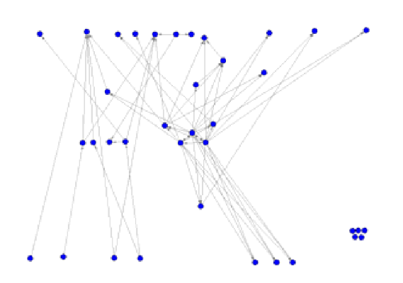
Why model social networks?
For example, the tendency to transitivity

Slide 6
Network processes
Exogenous effects:
  Homophily – shared affiliation, spatial propinquity matter (McPherson, Smith-Lovin & Cook, 2001)
  Network tie formation is set within foci (Feld, 1981), or settings (White, 1995; Pattison & Robins, 2002)
Endogenous effects:
  Clustering – tie formation is often more likely when actors have network partners in common (Cartwrith & Harary, 1956; Granovetter, 1973)
Interactions between exogenous and endogenous effects:
  General social selection (Robins, Elliott & Pattison, 2001)

Slide 7
Modeling endogenous network processes
Guiding principles:
  Network ties are the outcome of (unobserved) social processes that tend to be local and interactive
  There are both regularities and irregularities in these local interactive processes
Statistical models are constructed such that
  Local interactivity is permitted and assumptions about the form of ‘local interactions’ are explicit
  Regularities are represented by model parameters and estimated from the data
  Consequences of local regularities for global network properties can be understood and used for model evaluation

Slide 8
Modeling endogenous network processes
What is modeled?
  Tie variables:
  Node-level exogenous attribute variables are incorporated (Y)
Dependence assumption determine the neighborhoods
    Share an actor (Markov) Configurations for neighborhood
    Realization-Dependent
Edge 2-star 3-star 4-star … Triangle
L(x) S₂(x) S₃(x) S₄(x) T(x)
4-cycle 2-triangle …

Slide 9
Dependence assumptions
Bernoulli
  Possible edges are independent of each other
    Yields one parameter for each possible edge (too many!)
    Can assume that the edge effect is the same across the network (homogeneity assumption: λ_{ij} = θ)
    where L is the number of edges

Slide 10
Dependence assumptions
Dyadic independence
  Useful for directed graphs
  Dyads are assumed to be independent of one another
    Yields two parameters: one for the probability of dyads to exist, and one for the probability of a mutual tie to exist within the dyads
    where L is the number of arcs and M the number of reciprocal arcs in the observed network

Slide 11
Dependence assumptions
Other more relaxed Bernoulli-based homogeneity assumptions: Two-blocks
  Homogenous Bernoulli
  Bernoulli Blockmodel
  Homogeneous Dyad-independent
  Dyad-independent block
  Dyad-independent block with block reciprocity parameters

Slide 12
Dependence assumptions
Markov random graphs
  Edges are conditionally independent if and only if they share a node
Given the parameters, several random graphs are simulated to generate a distribution with which to compare the observed network

Slide 13
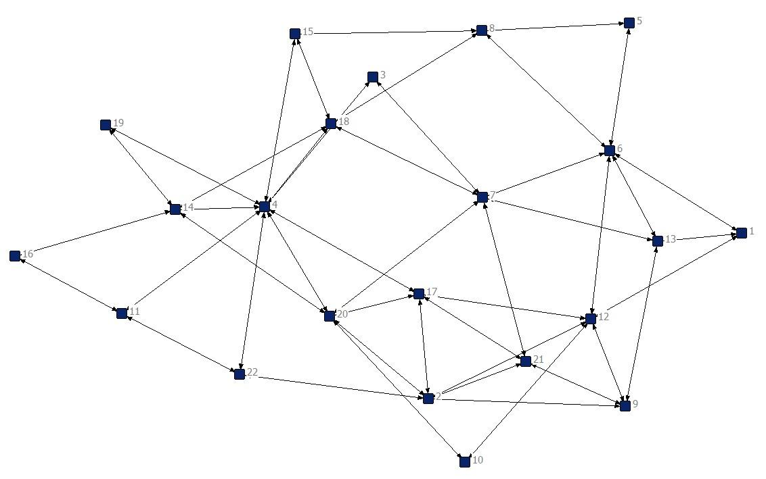
Random Graphs
Random graphs:
Random graphs for 22 nodes, 0.2 density:
  Parameters
    Edge = -2

Slide 14
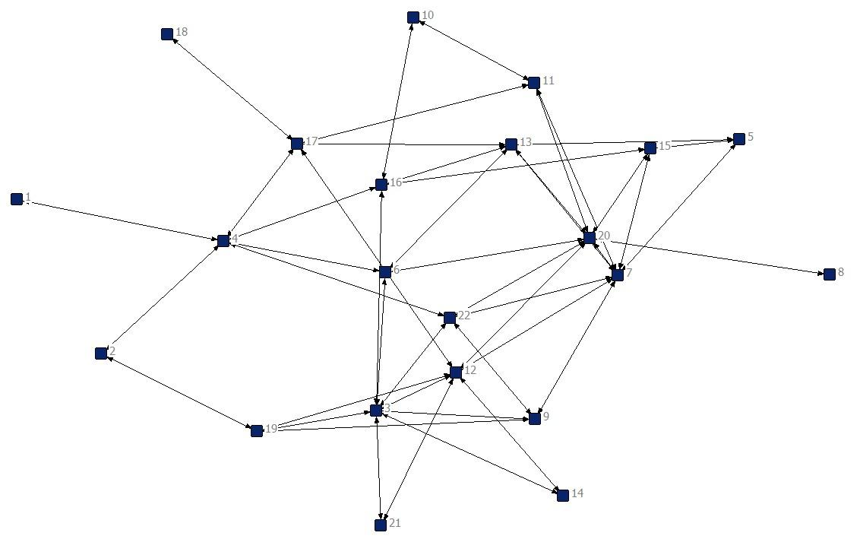
Random Graphs
Random graphs:
Random graphs for 22 nodes, 0.2 density:
  Parameters
    Edge = -2
    2-star = 0.5
    3-star = -0.3

Slide 15
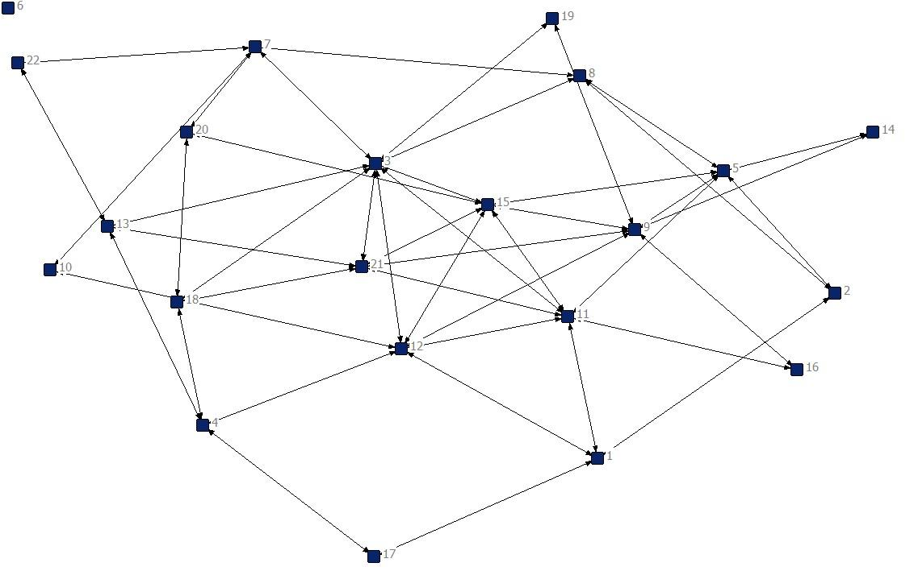
Random Graphs
Random graphs:
Random graphs for 22 nodes, 0.2 density:
  Parameters
    Edge = -2
    2-star = 0.5
    3-star = -0.3
    Triangle = 1

Slide 16
Parameter estimation
Estimate the most likely values for the edge, 2-star, 3-star, triangle parameters and test this value against a specific value (usually 0).
  The statistical test is performed using the Markov random graphs
  The estimations is done with pseudo-likelihood or Monte Carlo Markov chain maximum likelihood
Available software: PNet
  http://www.sna.unimelb.edu.au/pnet/pnet.html
  Download the manual and the “PNet for Dummies” guide and read the Readme.txt file prior to downloading
  Other software: SIENA in STOCNET, SatNet module in R

Slide 17
Parameter estimation
Example: Fifth grade data using PNet
 | Estimate | Std Error | Sig
Arc: | -1.148 | 1.586
Reciprocity: | 2.396 | 1.178
2-In-Star: | 0.260 | 0.396
2-Out-Star: | -0.001 | 0.289
3-In-Star: | -0.076 | 0.074
3-Out-Star: | -0.017 | 0.040
Mixed-2-Star: | -0.308 | 0.140
030T: | 0.499 | 0.074
030C: | -0.459 | 0.224
Network is smaller than expected
However, once a contact is made, it is likely to be reciprocal
High tendency towards transitive triangles, but not complete triangles

Slide 18
Modeling exogenous network processes
Homophily: are ties more likely among individuals that share certain attributes?
  Is the tie more likely once we consider Y?
  We add another parameter to control for the attributes

Slide 19
Modeling exogenous network processes
In the fifth grade data set, are ties more likely once we consider gender?
 | Estimate | Std Error | Sig
Arc: | -0.679 | 0.985
Reciprocity: | 1.922 | 0.497 | *
2-In-Star: | 0.245 | 0.245
2-Out-Star: | -0.036 | 0.266
3-In-Star: | -0.064 | 0.056
3-Out-Star: | -0.006 | 0.052
Mixed-2-Star: | -0.333 | 0.078 | *
030T: | 0.372 | 0.093 | *
030C: | -0.176 | 0.218
Rb for Attribute 1 | 2.306 | 0.762 | *
Rs for Attribute 1 | -0.412 | 0.447
Rr for Attribute 1 | -1.391 | 0.687 | *

Slide 20
Modeling exogenous network processes
In the fifth grade data set, are ties more likely once we consider gender?
 | Estimate | Std Error | Sig
Arc: | -0.679 | 0.985
Reciprocity: | 1.922 | 0.497 | *
2-In-Star: | 0.245 | 0.245
2-Out-Star: | -0.036 | 0.266
3-In-Star: | -0.064 | 0.056
3-Out-Star: | -0.006 | 0.052
Mixed-2-Star: | -0.333 | 0.078 | *
030T: | 0.372 | 0.093 | *
030C: | -0.176 | 0.218
Rb for Attribute 1 | 2.306 | 0.762 | *
Rs for Attribute 1 | -0.412 | 0.447
Rr for Attribute 1 | -1.391 | 0.687 | *
Once ties exist, they are likely to be reciprocal

Slide 21
Modeling exogenous network processes
In the fifth grade data set, are ties more likely once we consider gender?
 | Estimate | Std Error | Sig
Arc: | -0.679 | 0.985
Reciprocity: | 1.922 | 0.497 | *
2-In-Star: | 0.245 | 0.245
2-Out-Star: | -0.036 | 0.266
3-In-Star: | -0.064 | 0.056
3-Out-Star: | -0.006 | 0.052
Mixed-2-Star: | -0.333 | 0.078 | *
030T: | 0.372 | 0.093 | *
030C: | -0.176 | 0.218
Rb for Attribute 1 | 2.306 | 0.762 | *
Rs for Attribute 1 | -0.412 | 0.447
Rr for Attribute 1 | -1.391 | 0.687 | *
Transitive triangles are more likely than what would be expected by random

Slide 22
Modeling exogenous network processes
In the fifth grade data set, are ties more likely once we consider gender?
 | Estimate | Std Error | Sig
Arc: | -0.679 | 0.985
Reciprocity: | 1.922 | 0.497 | *
2-In-Star: | 0.245 | 0.245
2-Out-Star: | -0.036 | 0.266
3-In-Star: | -0.064 | 0.056
3-Out-Star: | -0.006 | 0.052
Mixed-2-Star: | -0.333 | 0.078 | *
030T: | 0.372 | 0.093 | *
030C: | -0.176 | 0.218
Rb for Attribute 1 | 2.306 | 0.762 | *
Rs for Attribute 1 | -0.412 | 0.447
Rr for Attribute 1 | -1.391 | 0.687 | *
If both actors share the attribute (male), it is more likely that they will have a tie

Slide 23
Modeling exogenous network processes
In the fifth grade data set, are ties more likely once we consider gender?
 | Estimate | Std Error | Sig
Arc: | -0.679 | 0.985
Reciprocity: | 1.922 | 0.497 | *
2-In-Star: | 0.245 | 0.245
2-Out-Star: | -0.036 | 0.266
3-In-Star: | -0.064 | 0.056
3-Out-Star: | -0.006 | 0.052
Mixed-2-Star: | -0.333 | 0.078 | *
030T: | 0.372 | 0.093 | *
030C: | -0.176 | 0.218
Rb for Attribute 1 | 2.306 | 0.762 | *
Rs for Attribute 1 | -0.412 | 0.447
Rr for Attribute 1 | -1.391 | 0.687 | *
Boys receive less ties than you would expect by chance from girls

Slide 24
Modeling exogenous network processes
In the fifth grade data set, are ties more likely once we consider gender?
 | Estimate | Std Error | Sig
Arc: | -0.679 | 0.985
Reciprocity: | 1.922 | 0.497 | *
2-In-Star: | 0.245 | 0.245
2-Out-Star: | -0.036 | 0.266
3-In-Star: | -0.064 | 0.056
3-Out-Star: | -0.006 | 0.052
Mixed-2-Star: | -0.333 | 0.078 | *
030T: | 0.372 | 0.093 | *
030C: | -0.176 | 0.218
Rb for Attribute 1 | 2.306 | 0.762 | *
Rs for Attribute 1 | -0.412 | 0.447
Rr for Attribute 1 | -1.391 | 0.687 | *
Likelihood that boys (attribute 1) are sending ties to girls (non attributes)

